Slide 1
Travel Behaviour Reconsidered in an Era of Decarbonisation
David Metz
UCL Centre for Transport Studies

Slide 2
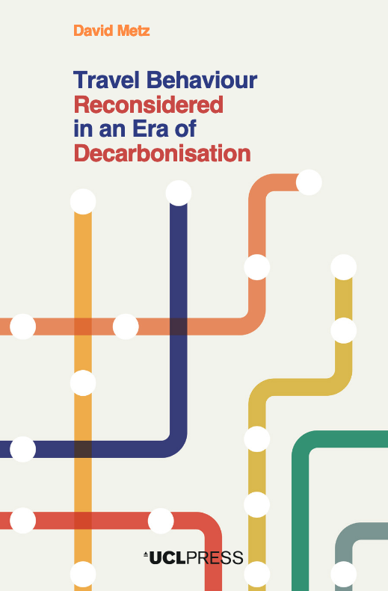

Slide 3
The need to reconsider travel behaviour
Understand the scope for reducing travel to help meet Net Zero objective
Question assumptions about travel behaviour that underlie orthodox transport economic appraisal and modelling

Slide 4
Car dependence (1)
Car responsible for 61% of trips and 77% of distance travelled in 2019
76% of households own at least one car
Two thrusts to critique
Places: eg new housing on greenfield sites with no alternative to the car
People who prefer the car when active modes and public transport available
Critique has been widely endorsed by planners and academics, but has had little impact on car ownership and use
Problems of high level of car use well recognized, but attractions tend to be underestimated:
Utility in getting from A to B, when congestion is not too severe and parking possible and affordable at both ends of trip
Feel good factors
Low marginal costs of operation

Slide 5
Car dependence (2)
Car vehicle-miles-travelled
80% from trips of more than 5 miles
95% from trips of more than 2 miles
Predominance of the car reflects the low density built environment that we have inherited, within which nearly all trip origins and destinations occur – travel is a derived demand
New build housing adds only about 1% pa to stock
Some repurposing possible through changes to planning
Accommodating population growth and housing shortage:
on greenfield sites, means more car use
on urban brownfield, infill and ‘gentle densification’ – public transport more important
in new towns – freestanding or urban extensions
Implications
Attractions of the car and the inherited built environment limit scope for behavioural change that would reduce car use
Best opportunities in cities where rail/trams are competitive with travel on congested roads
Transport decarbonisation to be achieved very largely through electrification

Slide 7
Mode share in Copenhagen and London

Slide 8
Impact of the pandemic

Slide 9
Trends in Travel per capita

Slide 10
Explaining travel trends
Invariant average per capita travel time since humans settled in communities
Travelling further in invariant time attributed to faster travel made possible by fossil fuel energy
The benefits of investment in faster travel taken as greater access (not the saving of travel time)
Growth ceased at turn of century because:
New technology no longer allows faster travel
Saturation of demand for travel

Slide 11
Older transport technologies

Slide 12
Newer transport technologies

Slide 13
Access to supermarkets
80% of UK urban population have choice of 3 or more large supermarkets within 15 min drive, 60% have 4 or more
Generally, those with a car in the household, and/or decent public transport, have good levels of choice of regularly used destinations

Slide 14
Access
Subject to diminishing returns
Increases with square of speed of travel
Therefore travel demand saturates – per capita travel ceases to increase
Travel time savings not a good proxy for access benefits
Economic appraisal needs to compare access in the with- and without-investment cases
Increased access implies more VMT and externalities, including carbon, than if benefits were taken as time saving

Slide 15
Transport system maturity
Travel demand saturation implies a presumption that transport system is mature
Accepted for urban roads
Propose for interurban roads
Maintain and make best use of existing infrastructure

Slide 16
Interurban traffic
Congestion at peak flow prompts highway engineers to propose capacity increase
But morning and afternoon peaks indicate use by commuters, who have other choices

Slide 17
Commuters have choices of route
New capacity attracts local traffic
Facilitated by digital navigation (satnav)
Can’t build our way out of congestion
Prediction of journey times - the best means of reducing uncertainty arising from congestion
Case study is an example of test of predictive validity of model – which failed

Slide 18
Problems with transport modelling
Models are complex and opaque, understood only by experts
Lack of predictive validation – comparing outturn with forecast at sufficient granularity
Inability to model changes in access
So traffic model outputs are constrained to a counterfactual case which disregards changes in access
Conclusion: models cannot be relied on to estimate economic benefits or carbon emissions

Slide 19
Analysis of mature networks
Economic analysis and modelling to focus on operations of road network, not investment in new capacity
Exploit wide use of digital navigation (satnav) to improve operational management and modelling of road network
Consider additional capacity only as part of proposals to access land brought into new uses.

Slide 20
Conclusions
Future travel demand
no need to plan for per capita growth,
plan to accommodate population growth
Higher density of new homes allows more choice of travel modes
Treat road network as generally mature and make best use by means of digital technologies
Recognise limited attractions for car owners of active travel and public transport
Mitigate harms from car use, eg 20mph zones, LTNs, satnav
Transport decarbonisation effected largely by means of electric propulsion

Slide 21
https://uclpress.co.uk/book/travel-behaviour-reconsidered-in-an-era-of-decarbonisation/
david.metz@ucl.ac.uk

